Slide 1

The Essence of Nested Composition
Xuan Bi*, Bruno C. d. S. Oliveira* and Tom Schrijvers**
20 July 2018, ECOOP, Amsterdam
* The University of Hong Kong
** KU Leuven

Slide 2
Family Polymorphism
In family polymorphism*, inheritance is extended to work on a family of classes
A family refers to a group of mutually recursive classes nested within another class
When one family extends another, it inherits (and can override) all the class members, as well as their relationships
It enables construction of highly extensible software frameworks
Most elegant solution to the Expression Problem
* Erik Ernst. Family Polymorphism (ECOOP’01)
Notes:
A powerful and long-standing idea in OOP
Including inheritance relations and subtyping relations

Slide 3
Ideal Solution*
class Lang { virtual class Exp { String show(); } virtual class Lit extends Exp { int value; Lit(int value) { this.value = value; } String show() { return value; } } virtual class Add extends Exp { Exp left, right; Add(Exp left, Exp right) { this.left = left; this.right = right; } String show() { return left.show() + " + " + right.show(); } } }
// Add a new operation
class LangEval extends Lang { refine class Exp { int eval(); } refine class Lit { int eval() { return value; } } refine class Add { int eval() { return left.eval() + right.eval(); } } }
// Add a new case
class LangNeg extends Lang { virtual class Neg extends Exp { Exp exp; Neg(Exp exp) { this.exp = exp; } String show() { return "-(" + exp.show() + ")"; } } }
class LangNegEval extends LangEval with LangNeg { refine class Neg { int eval() { return -exp.eval(); } } }
* Erik Ernst. The expression problem, Scandinavian style
Notes:
Mention virtual
Mention (1) inheritance is preserved (2) fields in Add are refined
Two extension are naturally combined by multiple inheritance, and filling in the missing definition of Neg

Slide 4
Nested Composition
Nested composition is an essential feature of family polymorphism
It allows automatic composition of nested classes at arbitrary depth
Designing a type system that fully supports nested composition is notoriously hard
Usually requires a dependent type system

Slide 5
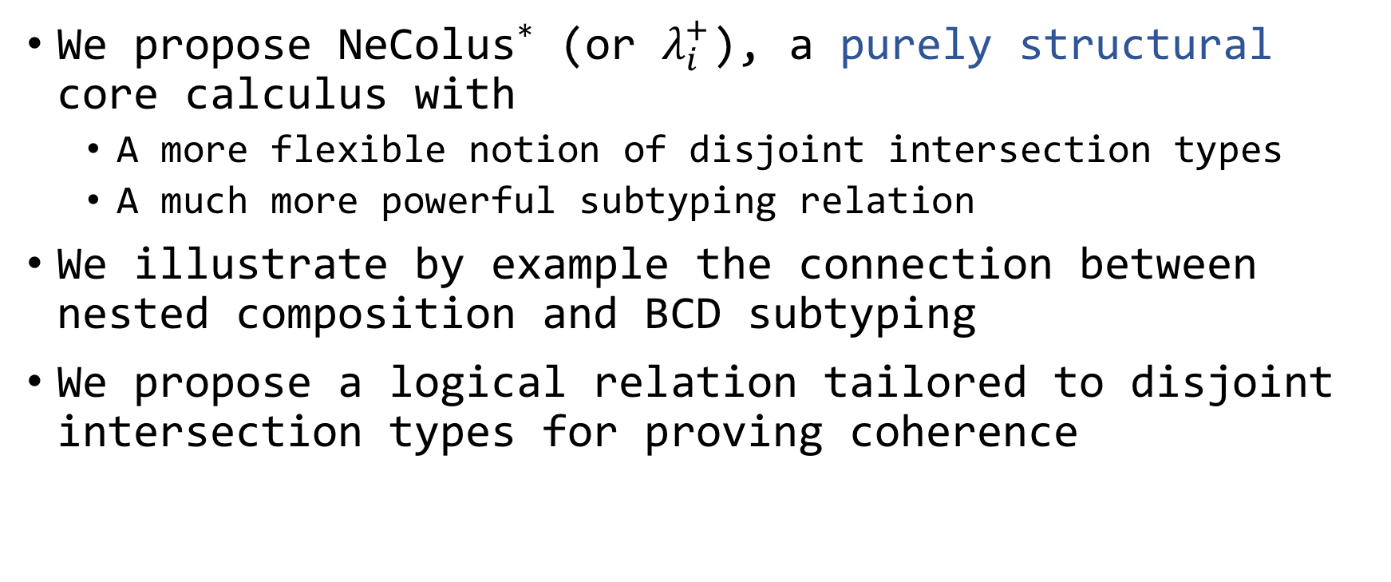
Contributions
We propose NeColus* (or $λ_{i}^{+}$), a purely structural core calculus with
A more flexible notion of disjoint intersection types
A much more powerful subtyping relation
We illustrate by example the connection between nested composition and BCD subtyping
We propose a logical relation tailored to disjoint intersection types for proving coherence
* NeColus stands for Nested Composition calculus

Slide 6

Two Pillars
Type Safety:
No type errors can happen at runtime
Coherence:
No ambiguity can happen at runtime
Verified in Coq!
Notes:
Coherence is very relevant for OOP, especially with multiple inheritance

Slide 7
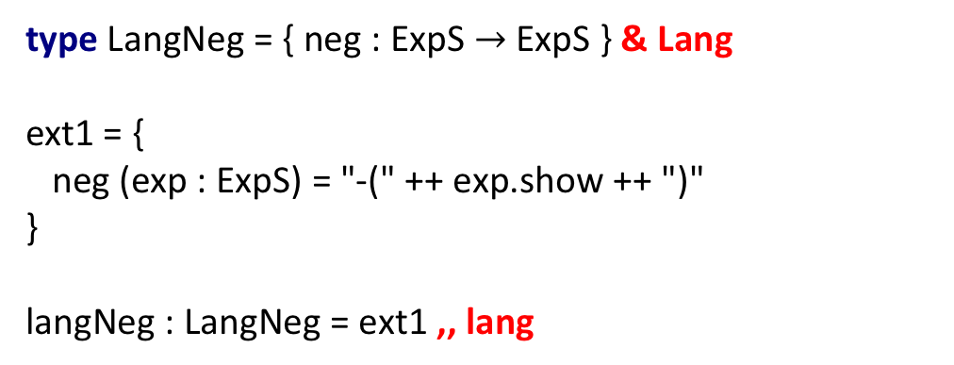
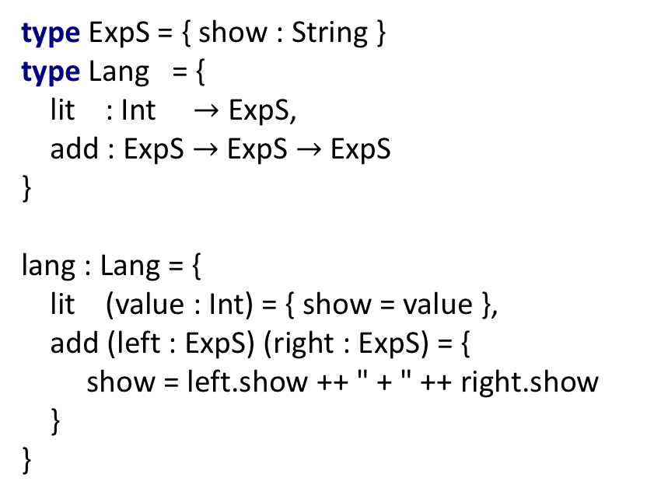
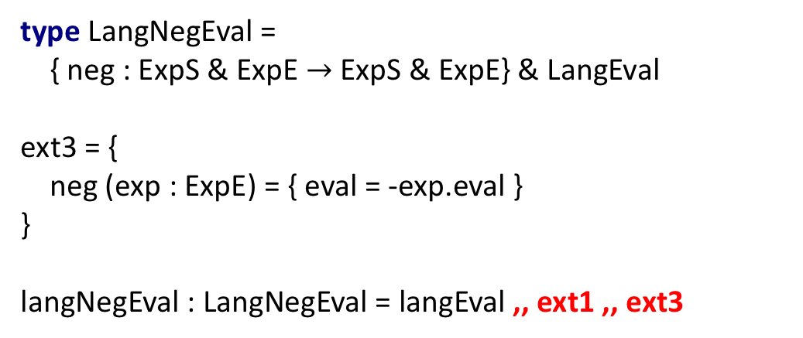
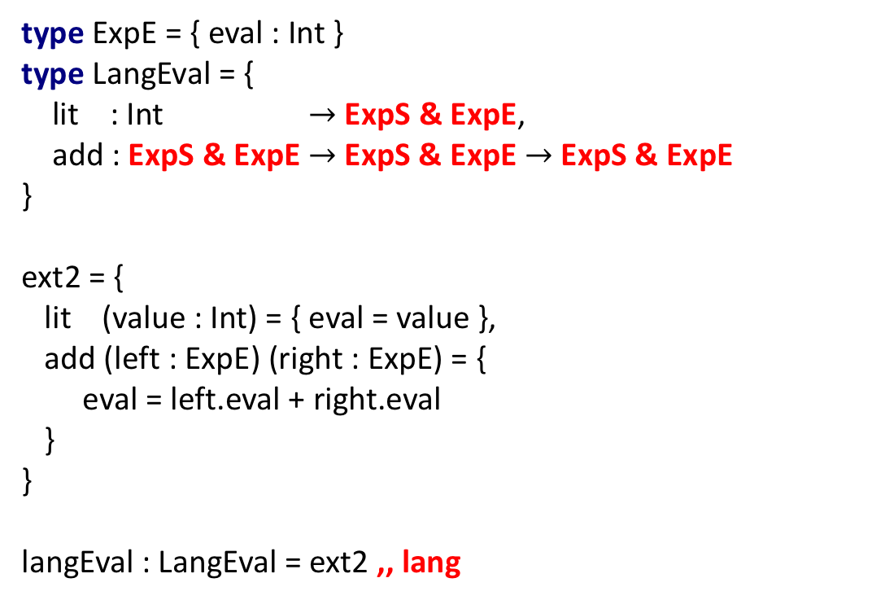
NeColus in Action
type LangNegEval =
{ neg : ExpS & ExpE $→$ ExpS & ExpE} & LangEval ext3 = { neg (exp : ExpE) = { eval = -exp.eval } }
langNegEval : LangNegEval = langEval ,, ext1 ,, ext3
type ExpE = { eval : Int } type LangEval = { lit : Int $→$ ExpS & ExpE, add : ExpS & ExpE $→$ ExpS & ExpE $→$ ExpS & ExpE }
ext2 = { lit (value : Int) = { eval = value }, add (left : ExpE) (right : ExpE) = { eval = left.eval + right.eval } }
langEval : LangEval = ext2 ,, lang
type ExpS = { show : String } type Lang = { lit : Int $→$ ExpS, add : ExpS $→$ ExpS $→$ ExpS } lang : Lang = { lit (value : Int) = { show = value }, add (left : ExpS) (right : ExpS) = { show = left.show ++ " + " ++ right.show } }
type LangNeg = { neg : ExpS $→$ ExpS } & Lang
ext1 = { neg (exp : ExpS) = "-(" ++ exp.show ++ ")" }
langNeg : LangNeg = ext1 ,, lang
lang
ext1
langNeg
langNegEval
ext2
ext3
langEval
fac = langNegEval e = fac.add (fac.neg (fac.lit 2)) (fac.lit 3) main = e.show ++ " = " ++ e.eval.toString
// Output: "-(2) + 3 = 1"
Notes:
the underlying mechanisms are very different
or we can merge langNeg

Slide 8

Disjoint Intersection Types
A variant* of intersection types: component types be disjoint
Merge operator
{m1 = 1, m2 = ‘c’} ,, {m3 = 3, m4 = ‘d’}
{m1 : Int, m2 : Char} & {m3 : Int, m4 : Char}
{m1 = 1, m2 = ‘c’} ,, {m1 = 3, m4 = ‘d’}
{m1 : Int, m2 : Char} & {m1 : Int, m4 : Char}
* Oliveira et al. Disjoint intersection types (ICFP’16)
Notes:
At a first approximation
not any two expressions can be merged, in the simplest case, two expressions with the same type cannot be merged, this will cause

Slide 9
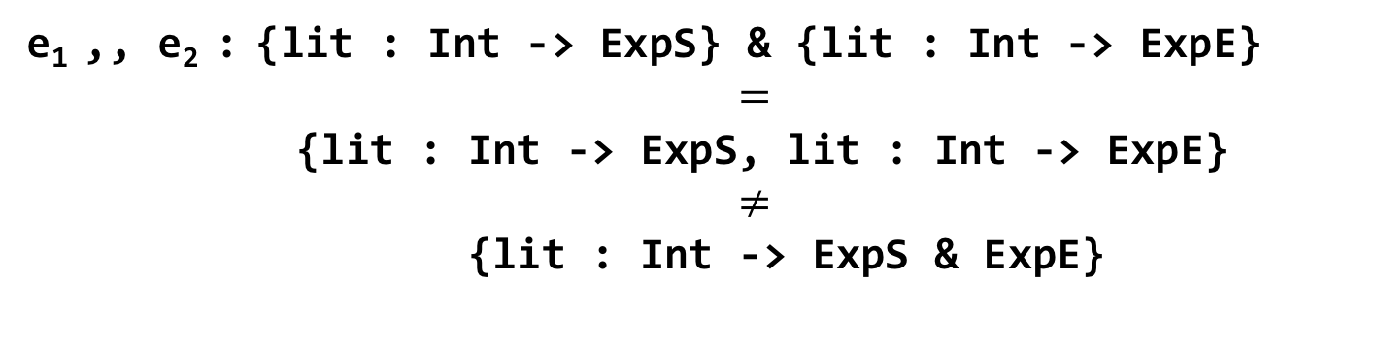
Typing Merge
e₁ : {lit : Int -> ExpS}
e₂ : {lit : Int -> ExpE}
e₁ ,, e₂ : {lit : Int -> ExpS} & {lit : Int -> ExpE}
$=$
{lit : Int -> ExpS, lit : Int -> ExpE}
$≠$
{lit : Int -> ExpS & ExpE}
Syntactic sugar
Notes:
It’s ok to have duplicate field as long as they have different types

Slide 10
Distributivity of Records
e₁ ,, e₂ : {lit : Int -> ExpS} & {lit : Int -> ExpE}
<:
{lit : (Int -> ExpS) & (Int -> ExpE)}

Slide 11
Distributivity of Functions
e₁ ,, e₂ : {lit : Int -> ExpS} & {lit : Int -> ExpE}
<:
{lit : (Int -> ExpS) & (Int -> ExpE)}
<:
{lit : Int -> ExpS & ExpE}
Notes:
From the user point of view

Slide 12
Elaboration

Slide 13
Elaboration of Intersections

Slide 14
Elaboration of Subtyping

Slide 15
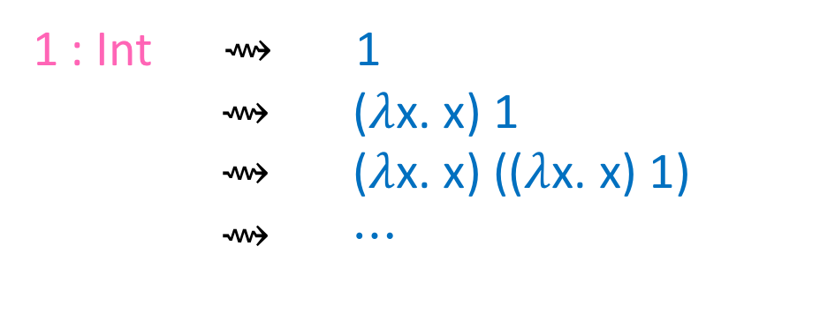
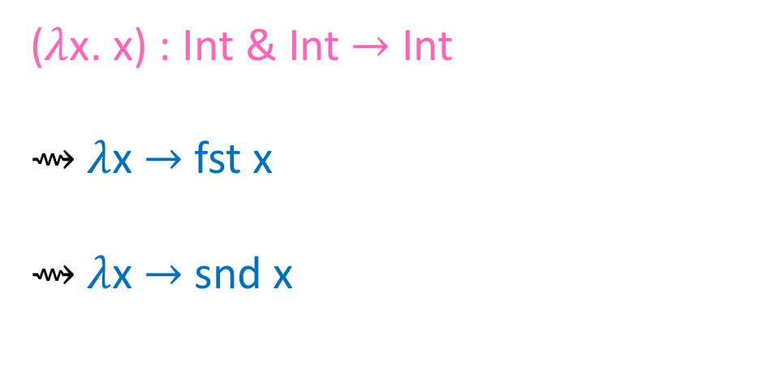
Coherence
1 : Int $⇝$ 1
$⇝$ ($λ$x. x) 1
$⇝$ ($λ$x. x) (($λ$x. x) 1)
$⇝$ $⋯$
A program has infinite number of translations
Hard to argue directly they have the same meaning (semantics)
($λ$x. x) : Int & Int $→$ Int
$⇝$ $λ$x $→$ fst x
$⇝$ $λ$x $→$ snd x
Notes:
The intuition is that the only source of ambiguity come from merges

Slide 16
Proof Strategy of Coherence

Slide 17
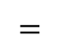
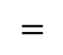
Logical Relations
values
indexed by types
Traditional homogenous (indexed by one type) logical relations are not adequate
<1, 2> should not be in the relation, whereas <1, 1> should
<1, <true, 1>>, <<2, false>, <1+1, ~true>>, …
$$=$$
$$=$$

Slide 18
Heterogenous Logical Relations
When are two values with given two types related?
Are the types disjoint? Then always
Are the type not disjoint? Then if the values are duplicates
Combine equality checking from tradition logical relations with disjointness checking
family of binary relations
translated values
indexed by two types

Slide 19
Logical Relation
Value: (1, <true, 1>) (1, 1) (1, true)
Relation: V(Int, Bool $×$ Int) $↠$ V(Int, Int) $⋀$ V(Int, Bool)

Slide 20
Also in the paper
Bi-directional type system
Algorithmic subtyping
Implemented in Haskell
Coq mechanization of all meta-theory

Slide 21
Future Work
Add parametric polymorphism
Coq formalization (type-safety and coherence) has been finished for predicative version
Add mutable state
Type safety should be easy, coherence is trickier

Slide 22
Thank you for listening!
Questions?

